Slide 1
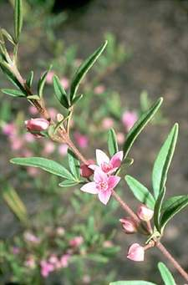
OUR
ENVIRONMENT
OUR
ENVIRONMENT

Slide 2
Meaning
All external conditions in which an organism lives. In simple words, our surroundings are our environment.
It is derived from a French word ‘environer’ which means to surround
Geography deals with several elements of our environment specially – natural and human made

Slide 3
Natural environment is of two types –biotic and abiotic

Slide 4


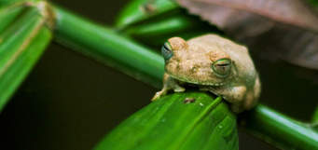
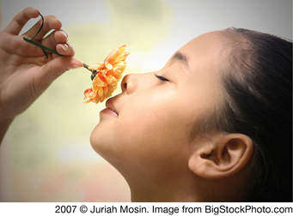
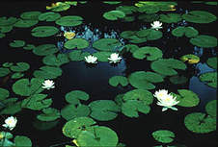
Biotic (living)

Slide 5
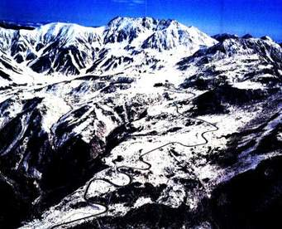
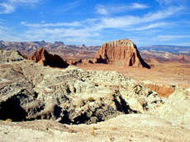
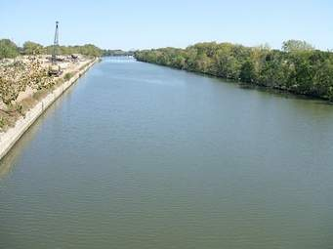
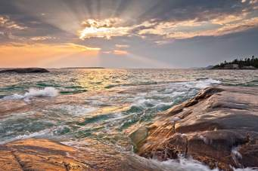
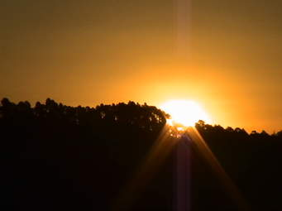
Abiotic(non living)

Slide 6
Zones of the Earth
All the biotic elements are distributed in the four domains of the earth namely-
Lithosphere(the rocky layer)
Hydrosphere (the water present on the earth)
Atmosphere (the air that surrounds the earth)
Biosphere (a narrow zone where the above three zones meet and interact. This is the zone that supports life.)

Slide 7
Human- environment interaction

Slide 8
Human beings are an important of part of natural environment. They adapt and modify the natural environment according to their needs.
Presently, human beings and their activities are the greatest danger to the natural environment.

Slide 9
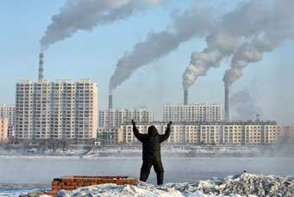
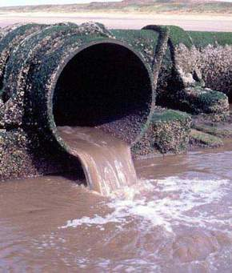
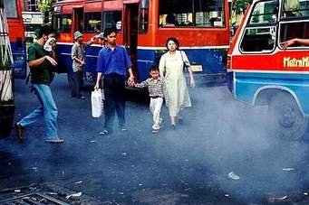
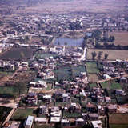
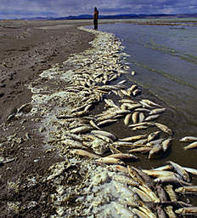
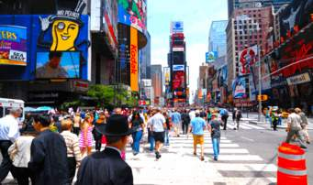

Slide 10
Environmental Pollution

Slide 11
The whole environment is facing problem due to technological and scientific development. The problems arising out of it are overpopulation, urbanization and industrialization. Environmental pollution is caused by reckless use of technology.

Slide 12
It is important for all of us to learn to live and use the natural environment in a harmonious way and maintain the balance of nature.

Slide 13
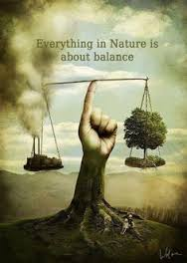

Slide 14
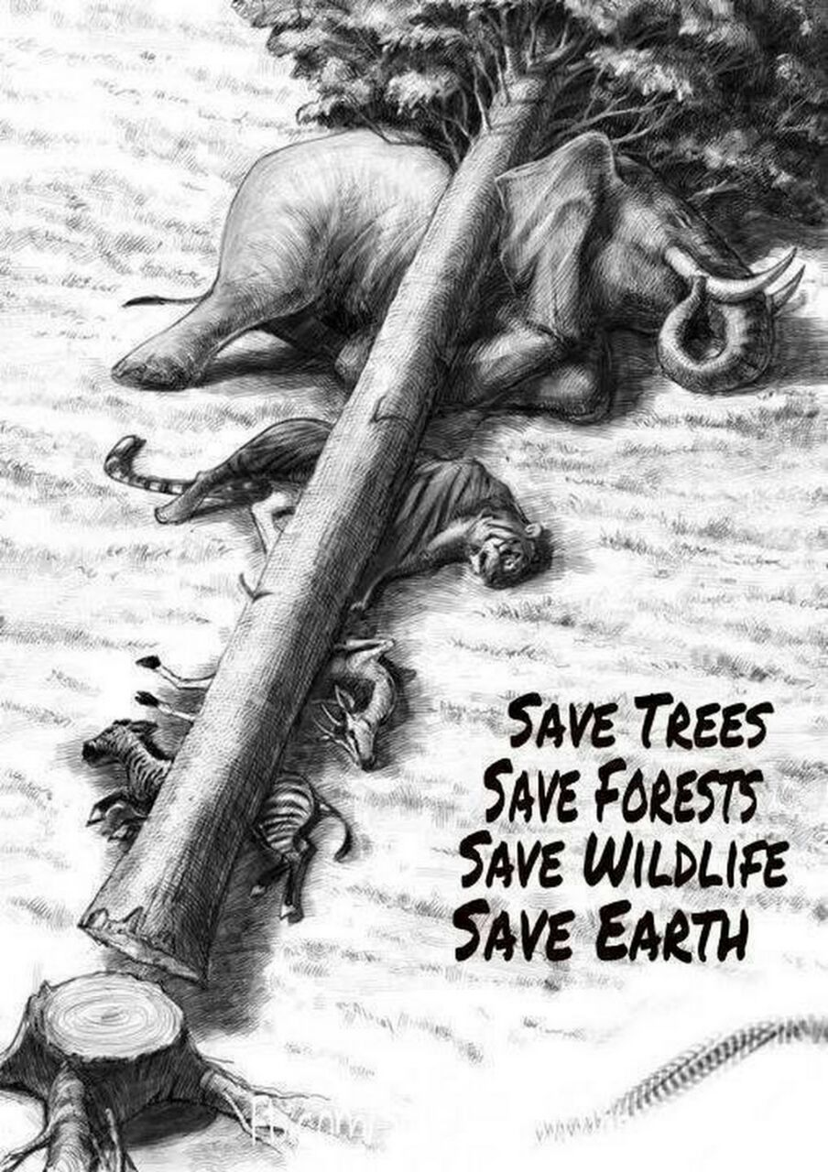
Last … but not the least………………

Slide 15


